Slide 1



Chapter
5
Normal Probability Distributions
© 2012 Pearson Education, Inc.
All rights reserved.
<number> of 105

Slide 2
Chapter Outline
5.2 Normal Distributions: Finding Probabilities
© 2012 Pearson Education, Inc. All rights reserved.
<number> of 105

Slide 3
Section 5.2
Normal Distributions: Finding Probabilities
© 2012 Pearson Education, Inc. All rights reserved.
<number> of 105

Slide 4
Section 5.2 Objectives
Find probabilities for normally distributed variables
© 2012 Pearson Education, Inc. All rights reserved.
<number> of 105

Slide 5
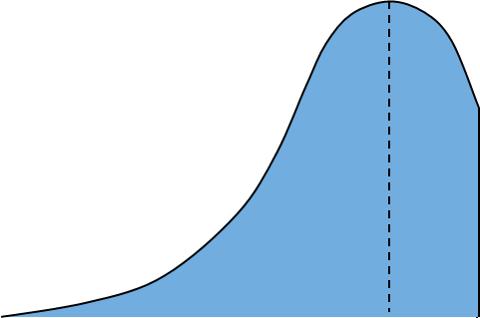
Probability and Normal Distributions
If a random variable x is normally distributed, you can find the probability that x will fall in a given interval by calculating the area under the normal curve for that interval.
P(x < 600) = Area
μ = 500
σ = 100
x
μ = 500
600
© 2012 Pearson Education, Inc. All rights reserved.
<number> of 105

Slide 6
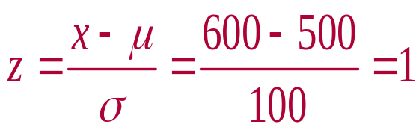
Probability and Normal Distributions
Normal Distribution
Standard Normal Distribution
μ = 500 σ = 100
μ = 0 σ = 1
P(x < 600)
P(z < 1)
x
z
μ =500
600
μ = 0
1
Same Area
P(x < 600) = P(z < 1)
© 2012 Pearson Education, Inc. All rights reserved.
<number> of 105

Slide 7
Example: Finding Probabilities for Normal Distributions
A survey indicates that people use their cellular phones an average of 1.5 years before buying a new one. The standard deviation is 0.25 year. A cellular phone user is selected at random. Find the probability that the user will use their current phone for less than 1 year before buying a new one. Assume that the variable x is normally distributed. (Source: Fonebak)
© 2012 Pearson Education, Inc. All rights reserved.
<number> of 105

Slide 8
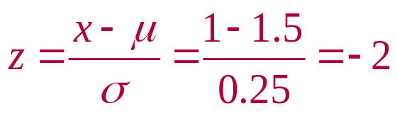
Solution: Finding Probabilities for Normal Distributions
Normal Distribution
Standard Normal Distribution
μ = 1.5 σ = 0.25
μ = 0 σ = 1
P(z < –2)
P(x < 1)
0.0228
x
z
1
1.5
–2
0
P(x < 1) = 0.0228
© 2012 Pearson Education, Inc. All rights reserved.
<number> of 105

Slide 9

Example: Finding Probabilities for Normal Distributions
A survey indicates that for each trip to the supermarket, a shopper spends an average of 45 minutes with a standard deviation of 12 minutes in the store. The length of time spent in the store is normally distributed and is represented by the variable x. A shopper enters the store. Find the probability that the shopper will be in the store for between 24 and 54 minutes.
© 2012 Pearson Education, Inc. All rights reserved.
<number> of 105

Slide 10
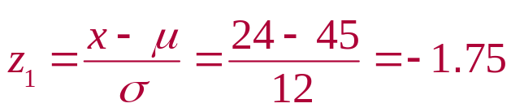
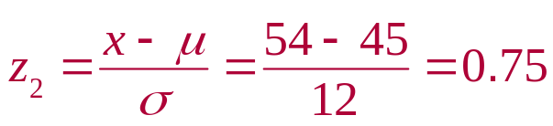
Solution: Finding Probabilities for Normal Distributions
Normal Distribution
μ = 45 σ = 12
Standard Normal Distribution
μ = 0 σ = 1
P(–1.75 < z < 0.75)
P(24 < x < 54)
0.7734
0.0401
x
z
24
45
54
–1.75
0
0.75
P(24 < x < 54) = P(–1.75 < z < 0.75)
= 0.7734 – 0.0401 = 0.7333
© 2012 Pearson Education, Inc. All rights reserved.
<number> of 105

Slide 11
Example: Finding Probabilities for Normal Distributions
If 200 shoppers enter the store, how many shoppers would you expect to be in the store between 24 and 54 minutes?
Solution:
Recall P(24 < x < 54) = 0.7333
200(0.7333) =146.66 (or about 147) shoppers
© 2012 Pearson Education, Inc. All rights reserved.
<number> of 105

Slide 12
Example: Finding Probabilities for Normal Distributions
Find the probability that the shopper will be in the store more than 39 minutes. (Recall μ = 45 minutes and
σ = 12 minutes)
© 2012 Pearson Education, Inc. All rights reserved.
<number> of 105

Slide 13
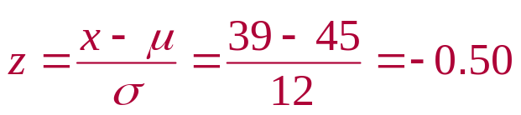
Solution: Finding Probabilities for Normal Distributions
Normal Distribution
μ = 45 σ = 12
Standard Normal Distribution
μ = 0 σ = 1
P(z > –0.50)
P(x > 39)
0.3085
x
z
39
45
–0.50
0
P(x > 39) = P(z > –0.50) = 1– 0.3085 = 0.6915
© 2012 Pearson Education, Inc. All rights reserved.
<number> of 105

Slide 14
Example: Finding Probabilities for Normal Distributions
If 200 shoppers enter the store, how many shoppers would you expect to be in the store more than 39 minutes?
Solution:
Recall P(x > 39) = 0.6915
200(0.6915) =138.3 (or about 138) shoppers
© 2012 Pearson Education, Inc. All rights reserved.
<number> of 105

Slide 15
Section 5.2 Summary
Found probabilities for normally distributed variables
© 2012 Pearson Education, Inc. All rights reserved.
<number> of 105

